Slide 1
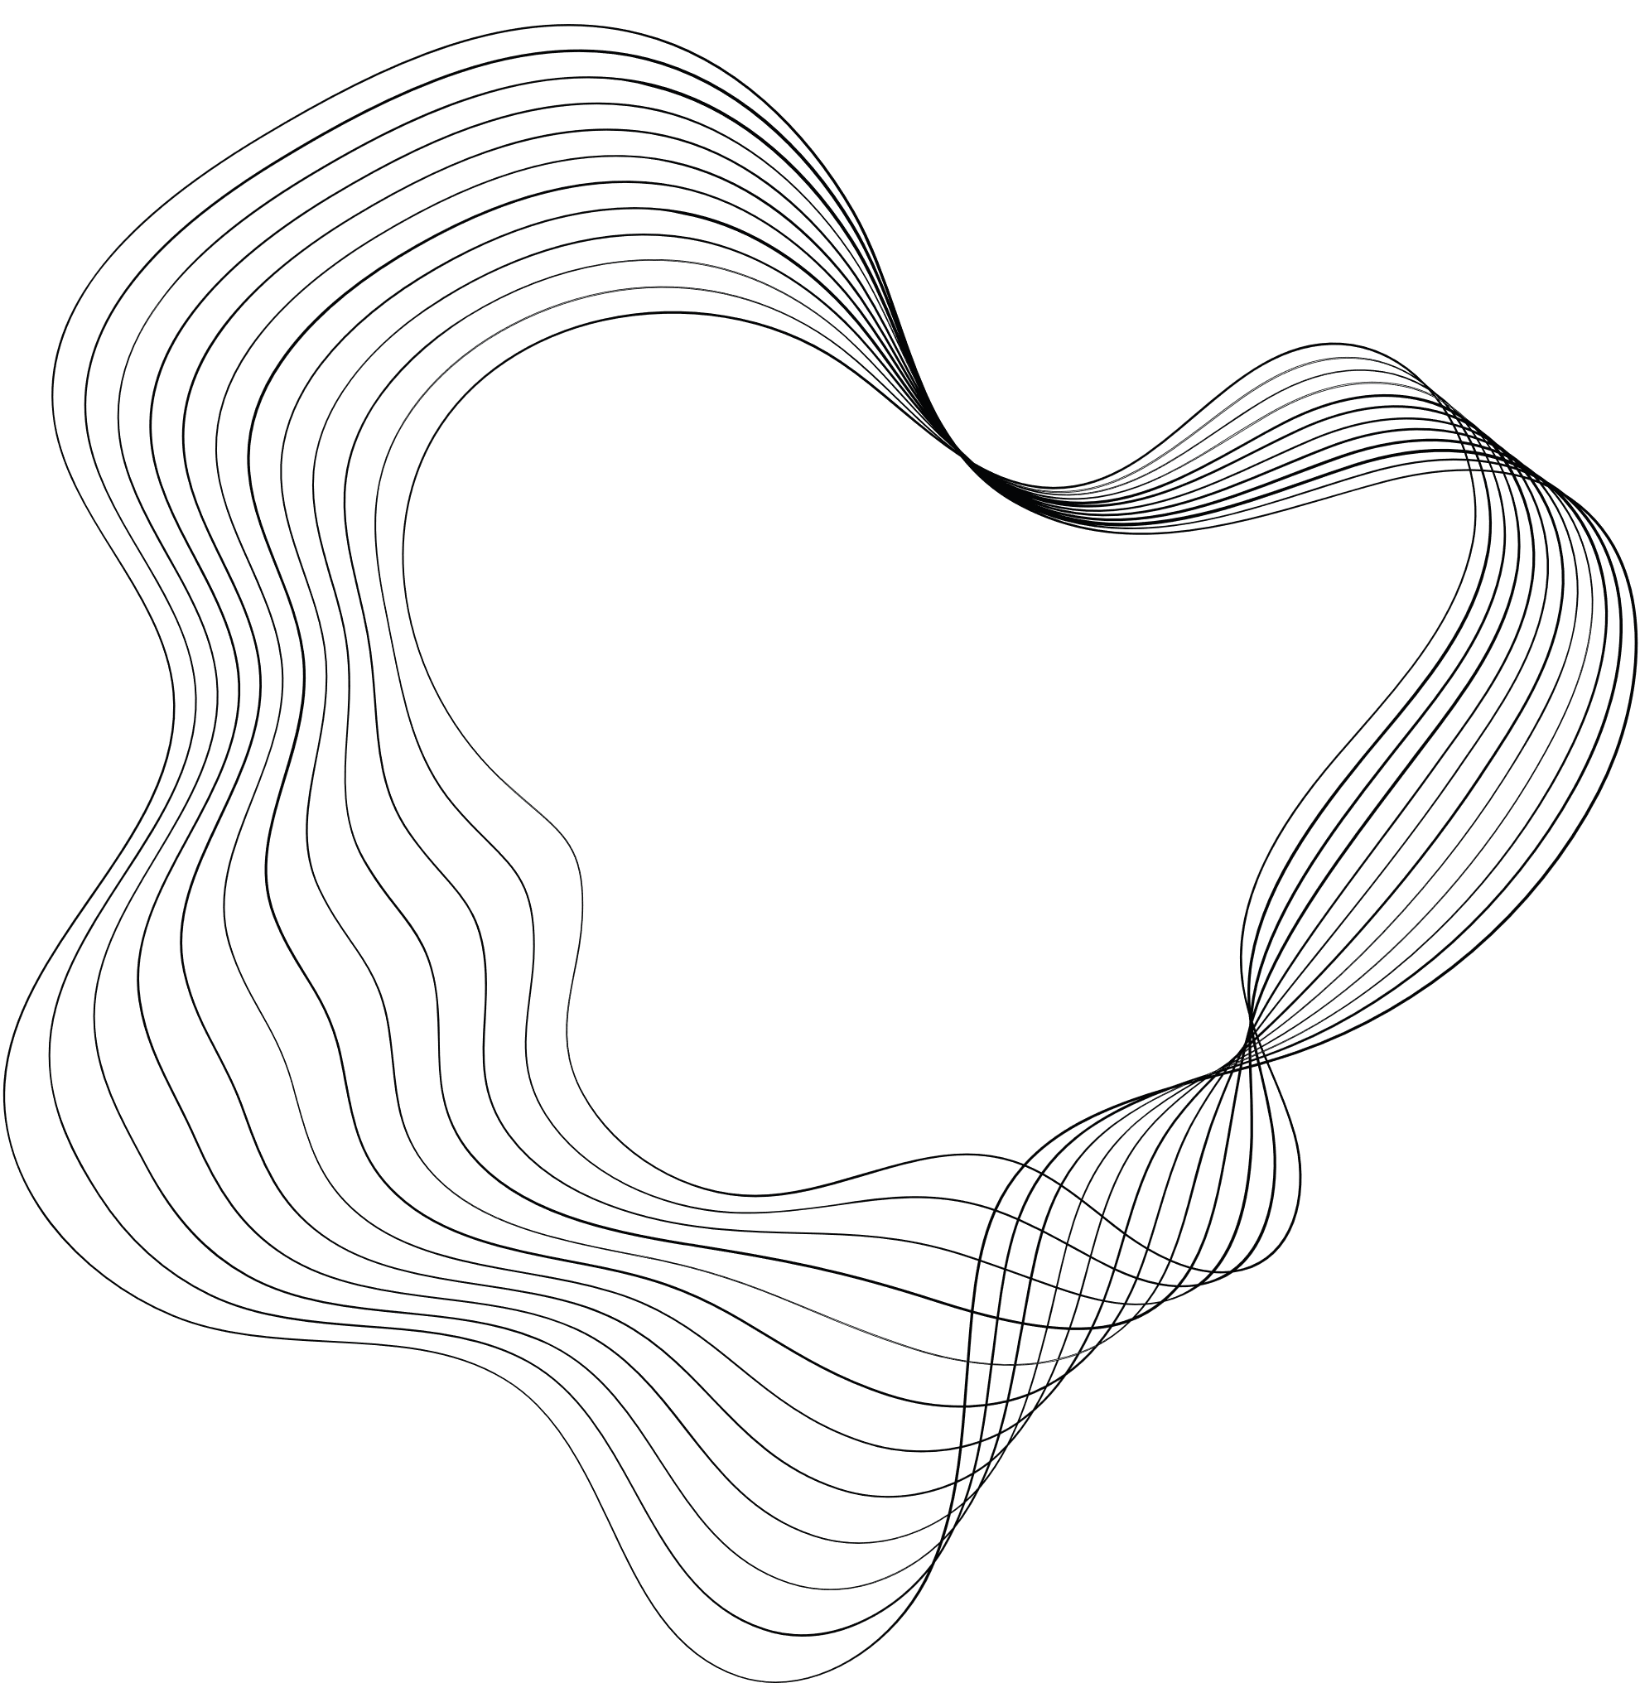





MATRIX
SPIRAL
VIJAY RICHHARIYA

Slide 2
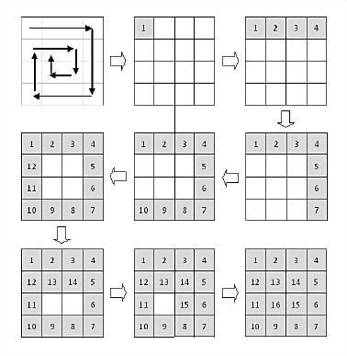
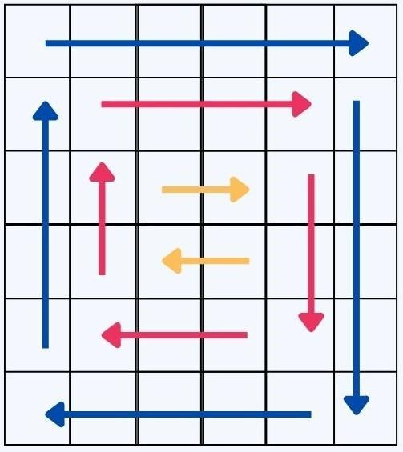


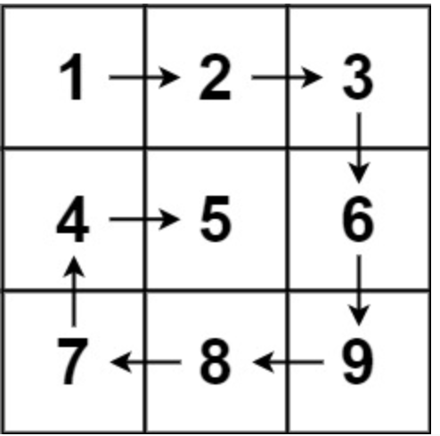

ABOUT US
A spiral matrix is a special type of two-dimensional matrix (array of arrays) in which the elements are arranged in a spiral pattern.
The arrangement starts from the top-left corner and proceeds in a clockwise direction, filling the matrix until all elements are placed. The size of the matrix is usually a square matrix, but it can be adapted for rectangular matrices as well.

Slide 3
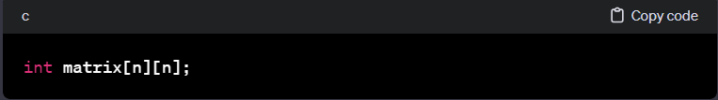
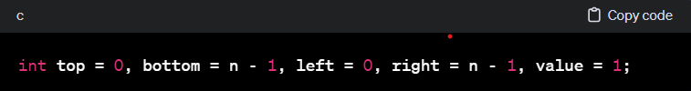


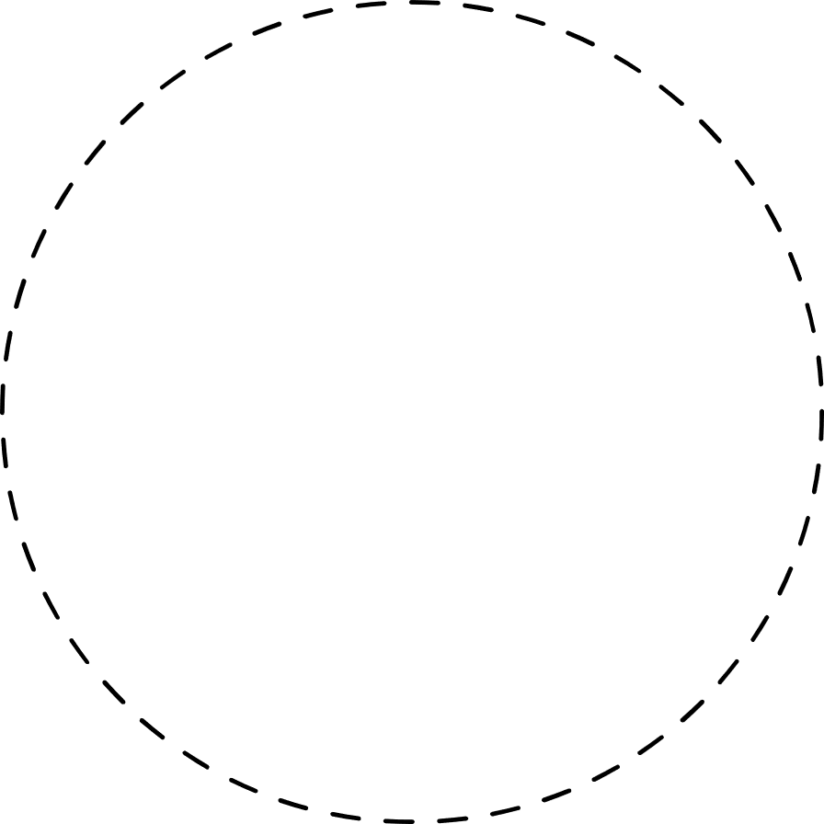


Algorithm: SpiralMatrix
STEP-1
STEP-2
Initialize variables:
Initialize an empty matrix:
top = 0: Represents the topmost row.
bottom = n - 1: Represents the bottommost row.
left = 0: Represents the leftmost column.
right = n - 1: Represents the rightmost column.
value = 1: Represents the current value to be assigned to the matrix
Create a 2D matrix of size n x n. This matrix will be used to store the generated spiral pattern

Slide 4
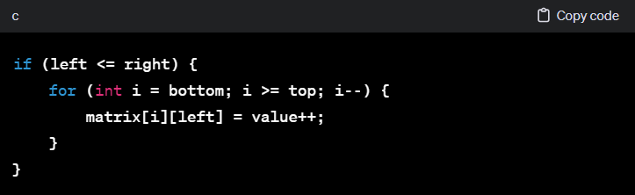
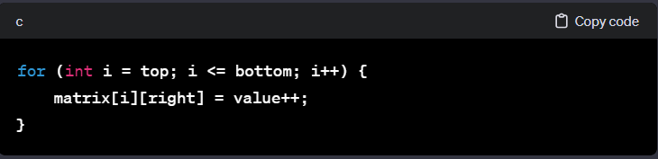
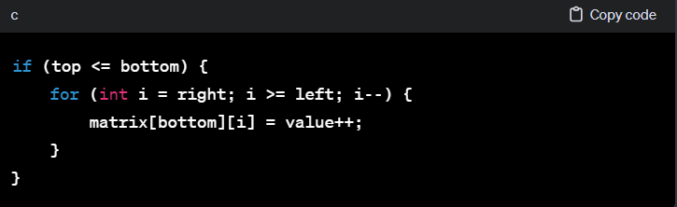
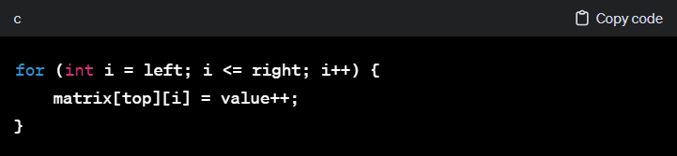
Algorithm: SpiralMatrix
Generate the Spiral Matrix:
d. Decrement right.
e. Bottom Row (right to left):
If top <= bottom, iterate from right to left along the bottom row (matrix[bottom][i]) and fill each element with the current value. Increment value.
f. Decrement bottom.
g. Leftmost Column (bottom to top):
If left <= right, iterate from bottom to top along the leftmost column (matrix[i][left]) and fill each element with the current value. Increment value.
b. Increment top.
c. Rightmost Column (top to bottom):
Iterate from top to bottom along the rightmost column (matrix[i][right]) and fill each element with the current value. Increment value.
While top <= bottom and left <= right, do the following:
a. Top Row (left to right):
Iterate from left to right along the top row (matrix[top][i])
and fill each element with the current value.
Increment value.

Slide 5
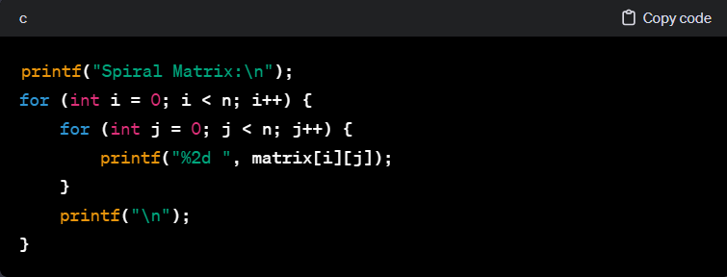
Algorithm: SpiralMatrix
STEP-4
Print the generated Spiral Matrix:
*Print the elements of the generated matrix.

Slide 6

CONCLUSION:
In conclusion, a spiral matrix is a unique arrangement of elements in a two-dimensional array, starting from the top-left corner and proceeding in a clockwise direction to fill the matrix in a spiral pattern. The construction involves initializing boundaries (top, bottom, left, and right) and incrementally filling the matrix until all elements are placed.
The algorithm, as demonstrated in the provided code, efficiently generates a spiral matrix of size n x n. The implementation uses a loop to traverse the boundaries, filling the matrix in a clockwise spiral order. The resulting matrix can be printed or utilized for various computations, providing a visually appealing arrangement of elements.
Understanding and implementing algorithms like the one for generating a spiral matrix can be valuable in computer science and programming. It not only enhances problem-solving skills but also contributes to a deeper understanding of matrix manipulation and traversal.
In summary, the provided code exemplifies the generation of a spiral matrix, showcasing the step-by-step process involved in creating this specific pattern within a two-dimensional array.

Slide 7

THANK'S FOR WATCHING

